Slide 1
Predicting the Daily Deaths due to COVID-19
Jasleen Singh

Slide 2
Predicting the Daily Deaths due to COVID-19 WILL be valuable for
WHO (World Health Organization)
Country administration
Citizens
Notes:
Insert a map of your country.

Slide 3
Data acquisition and cleaning
Data: https://covid.ourworldindata.org/data/owid-covid-data.csv
Meta-data: https://covid.ourworldindata.org/data/owid-covid-codebook.csv
In total, 42,770 rows in the raw dataset.
Used the data from 1st February, 2020 till 31st August, 2020
Notes:
Insert a picture of one of the geographic features of your country.

Slide 4
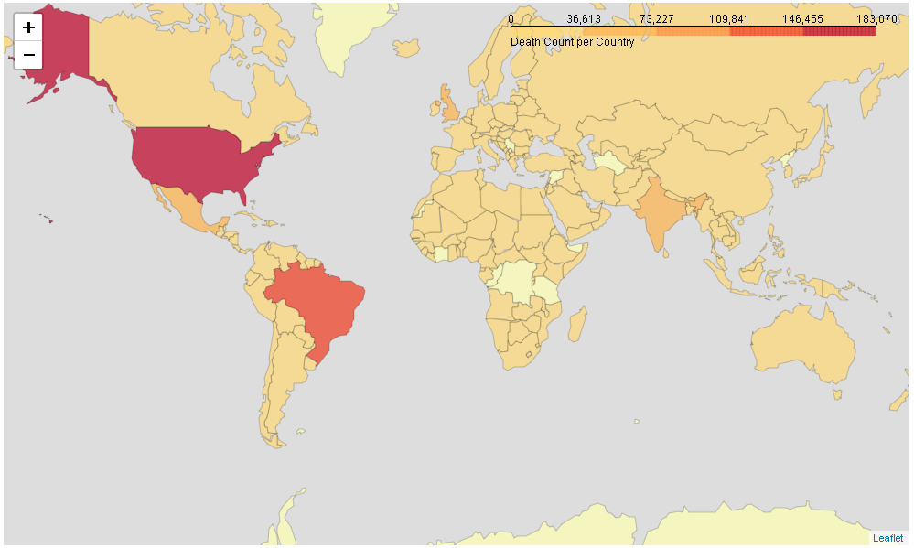
Data Visualization over World Map
Notes:
Insert a picture illustrating a season in your country.

Slide 5
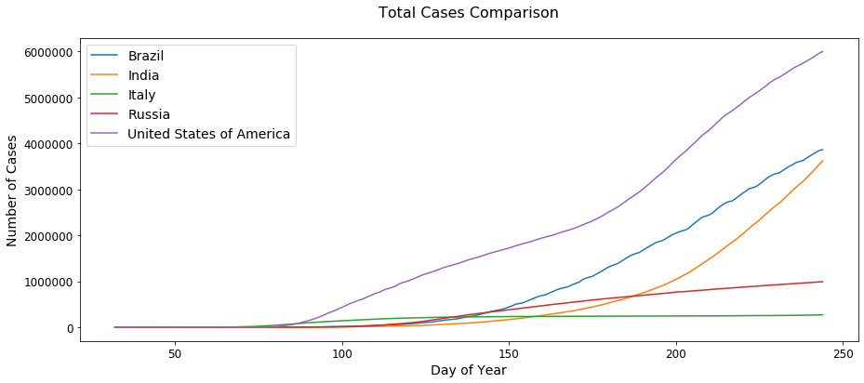
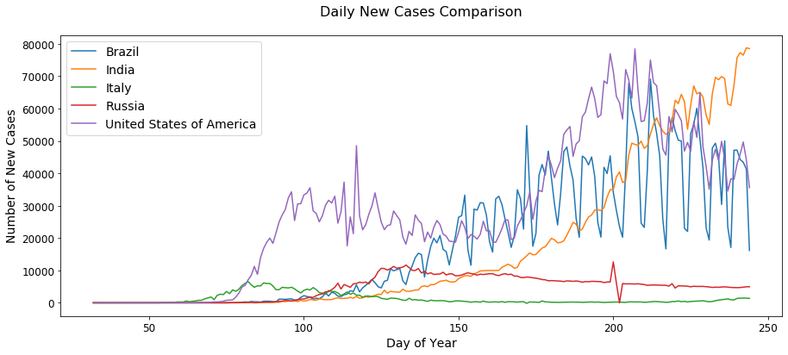
Time-series analysis of Total Cases and New Cases
Notes:
Insert a picture of an animal and or plant found in your country.

Slide 6
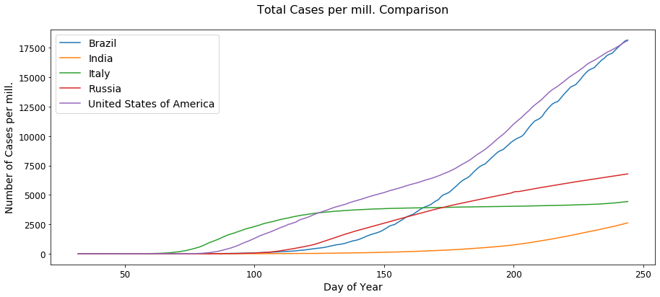
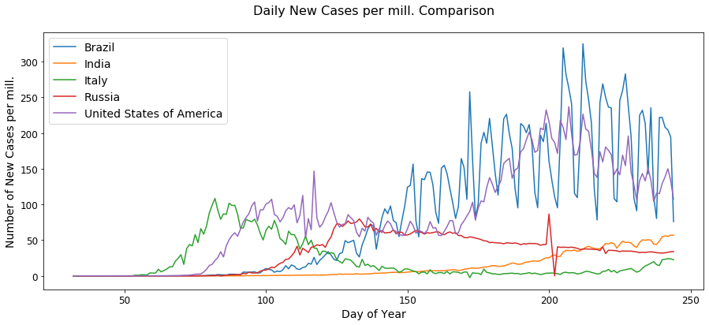
Time-series analysis of Total Cases and New Cases per million of population
Notes:
Add key points in the history of your country to the timeline.

Slide 7
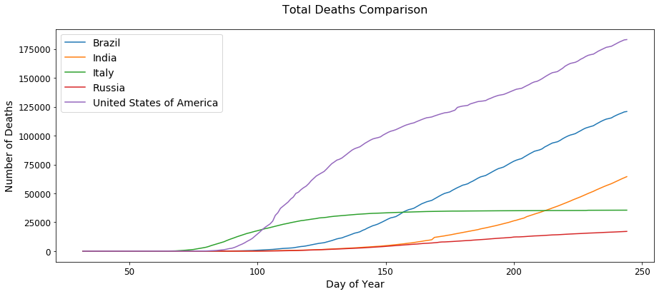
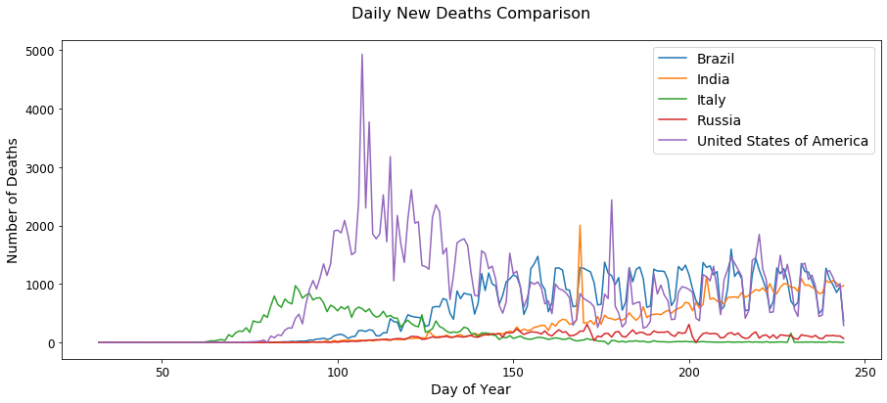
Time-series analysis of Total Deaths and New Deaths
Notes:
Insert a picture illustrating a custom or tradition here.

Slide 8
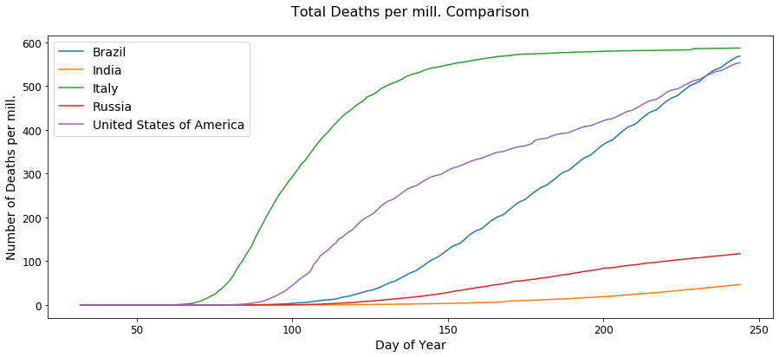
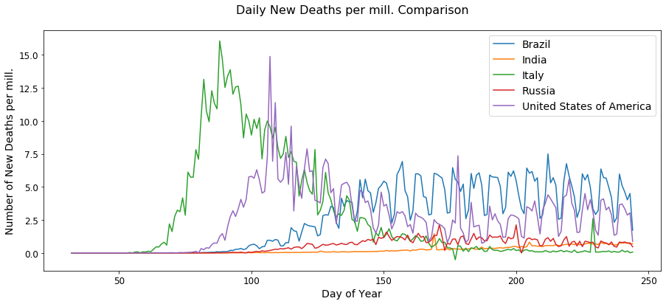
Time-series analysis of Total Deaths and New Deaths per million of population
Notes:
Insert a picture of the head leader of your country.

Slide 9
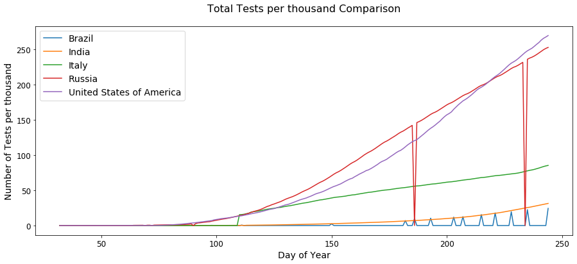
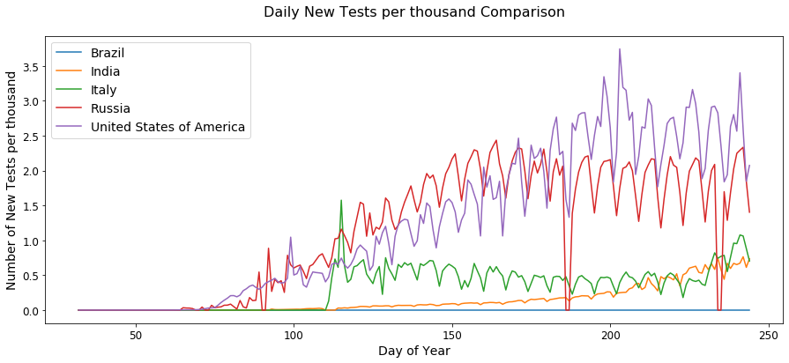
Time-series analysis of Total Tests and New Tests per thousand of population
Notes:
Insert a picture that illustrates some part of your country’s economy.

Slide 10
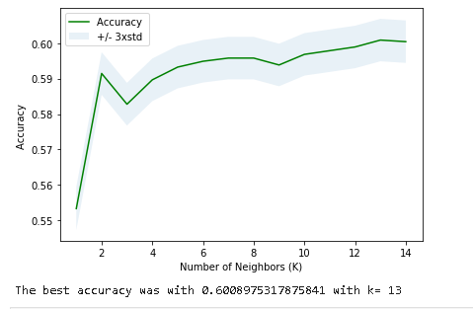
MACHINE LEARNING MODELS
K Nearest Neighbour (KNN)
Decision Tree
Support Vector Machine
Logistic Regression
Notes:
Insert a picture of one of the points of interest for your country.

Slide 11
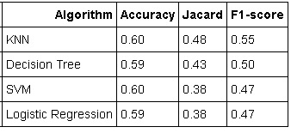
CONCLUSION
KNN performed best so-far as per the analysis and testing
More number of records required for countries like North Korea, China where data collection is not precisely done
Proper data collection needs to be done for countries which does not provide data on daily basis.
Notes:
Insert a picture of one of the points of interest for your country.

